Slide 1
6. Costs
Late prototype validations & testing
Hardware acquisition for prototype validations
Software initial expenses

Slide 2
7. Subcontracting activities
HIRO
Quality Control
Website development
Auditing – EN ROJO: SON LO MISMO?
Thales Alenia Space (SAS)
Manufacturing of payload sensors
Manufacturing of modular system

Slide 3
8. Quality improvement approach
DMAIC
Define
Measure
Analyze
Improve
Control
Acceptance criteria
Iterations to be approved
Stakeholders satisfaction
Time to be approved
Number of defects
Detect origin of problem
Propose solutions
Implement approved solutions
Assure a correct implementation of solutions

Slide 4
9. Risk management plan
Risk assessment by
Probability to happen
Impact on budget, schedule or scope/quality
Risk rated from 1 to 5 (Green to red)
Risk mitigation proposal
Evaluation of risk after solution implementation

Slide 5
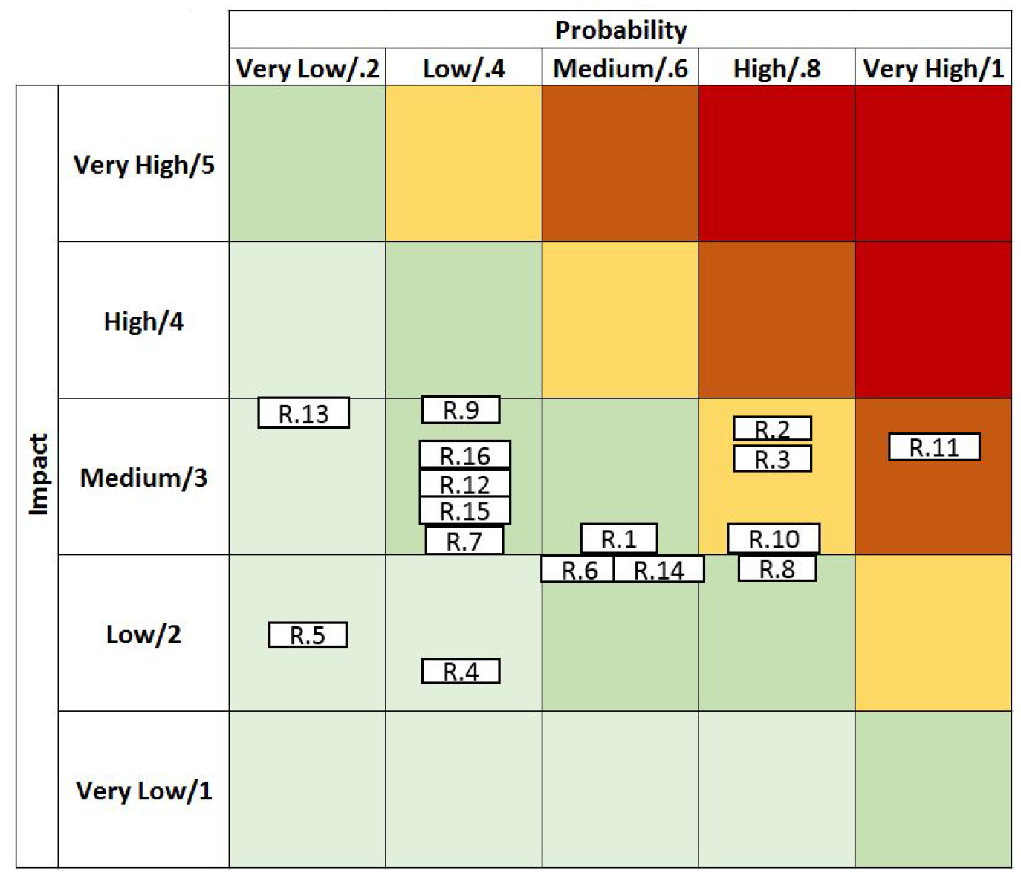
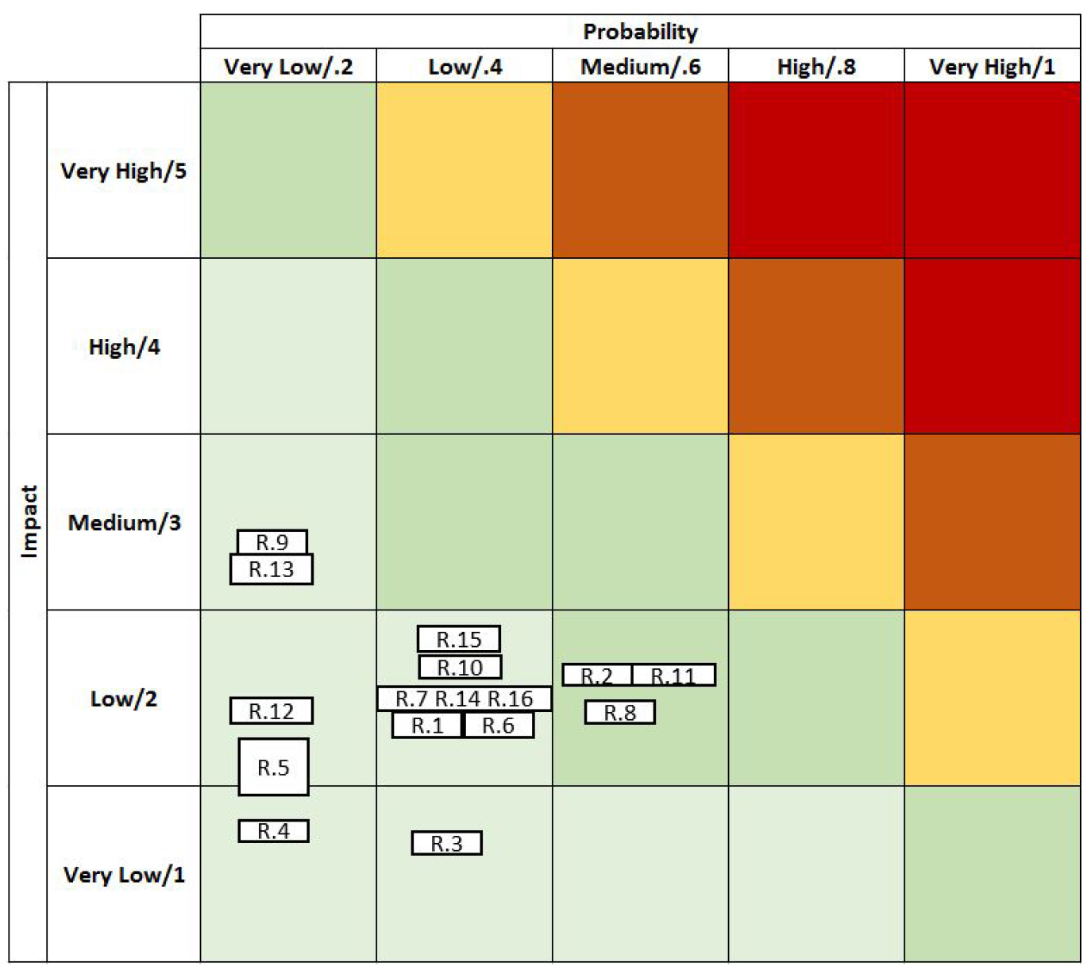
Before mitigation actions
After mitigation actions

Slide 6
10. Communication management plan
Frequency of the meetings | Communication type | Medium
Weekly | Internal business status meetings | F2F
 | Technical and business status meetings and reports | F2F
Monthly | Advisory committee meetings | F2F
 | Steering committee status meetings | F2F
 | Status meetings and reports to stakeholders | F2F / VC
 | Project status reports | e-mail
Scheduled | Conferences | Conference
 | Trade shows | Onsite stands
When available | Journal Articles | Digital or written platforms

